Slide 1
ARG Namkeen Pvt Ltd

Slide 2
Problem Statement
What is the problem/ need?
Problem: The main problem/need in the snacks business is to create snacks that are healthy, convenient, and innovative, while also differentiating themselves from the competition.
Need: Additionally, snack companies need to have efficient distribution networks to reach a wide customer base.

Slide 3
What is it Important?
There are Five Type of Important.
Convenience: Snacks are easy to consume on-the-go, making them a popular choice for busy people who don't have time for a full meal.
Variety: The snack industry offers a wide range of products, from sweet to savory, allowing consumers to satisfy different cravings.
Revenue: The snack industry is a multi-billion dollar industry, providing employment opportunities and contributing to the economy.
Innovation: Snack companies are constantly developing new products and flavors to keep up with changing consumer preferences and trends.
Marketing: Snacks are often marketed as a treat or indulgence, which can create a sense of happiness and satisfaction for consumers.

Slide 4
Who does it concern?
Consumers: The primary focus of the snack business is to provide convenient and tasty snacks that appeal to consumers.
Snack companies: We produce and sell snacks are important stakeholders in the Our business. We can develop new products, invest in marketing and advertising, and compete with other snack brands to gain market share.
Distributors and retailers: Distributors and retailers play a crucial role in getting snacks into the hands of consumers. They manage the supply chain and ensure that snacks are available in stores and online marketplaces.
Investors: Investors provide funding for Our Company to grow and expand their operations. They also monitor financial performance and make decisions about investments and divestments.
Regulators: Regulators ensure that snack products meet safety and quality standards. They may also regulate marketing and labeling practices to protect consumers.

Slide 5
Proposed Solution
How will you address the need/pain?
There are Five Type Address the need/pain.
Diversify product offerings: we can introduce new and innovative snack products that cater to the diverse taste preferences of Indian consumers. This could include healthier snack options, as there is an increasing demand for healthy snacking alternatives.
Improve distribution channels: We can improve their distribution channels by partnering with local retailers and e-commerce platforms to make their snacks more widely available to consumers across the country.
Enhance marketing and branding: We can invest in marketing and branding initiatives to increase brand visibility and customer engagement. This could include social media campaigns, influencer marketing, and experiential marketing events.
Emphasize affordability: Many Indian consumers are price-sensitive, so we can focus on offering affordable options to make their products accessible to a wider range of consumers.

Slide 6
Address food safety concerns: Food safety is a major concern for Indian consumers, so we can prioritize quality control measures and transparent labeling to build trust with consumers.
Overall, by diversifying products, improving distribution channels, enhancing marketing, emphasizing affordability, and addressing food safety concerns, we can address the need/pain points in the snack business in India and cater to the evolving needs of Indian consumers.

Slide 7
Describe specific Product/ Service?
One specific product/service in the snack business in India is packaged namkeens. Namkeens are savory snacks made from ingredients such as chickpea flour, rice flour, lentils, and spices. Packaged namkeens are pre-packaged and sold in stores and online marketplaces.
Packaged namkeens are popular in India because they are affordable, convenient, and come in a wide variety of flavors. Some popular namkeen flavors include masala, sev, bhujia, wafers, Kurkure and chakli. Namkeens are often consumed as a snack with tea or coffee, or as a side dish with meals.

Slide 8
Proposed Solution
The technology used in namkeen business in India involves several processes, including:
Mixing and Blending: Namkeens and wafers are made by blending different ingredients, such as flour, spices, and oil. Modern mixing and blending machines use technology such as sensors and automation to ensure that the ingredients are mixed evenly and consistently.
Cutting and Shaping: After the mixture is prepared, it is cut and shaped using machines that use precision blades and molds. These machines are designed to create uniform shapes and sizes of namkeens and wafers.

Slide 9
Frying or Baking: Namkeens and wafers are either fried or baked to give them their characteristic texture and crunch. Modern fryers and ovens use advanced technology to control temperature and cooking time, ensuring that the products are cooked evenly and have the desired texture.
Packaging: Finally, the finished products are packaged using automated packaging machines that use technology such as vacuum sealing and gas flushing to extend shelf life and preserve freshness.
Overall, technology plays an important role in the production of namkeens and wafers in India. By using advanced machines and processes, snack companies can increase efficiency, improve quality control, and cater to the changing demands of consumers

Slide 10
Novelty
Novelty in the snacks business refers to unique, innovative, or unusual snack products that capture consumers' attention and stand out from the competition. Novelty snacks can take various forms, such as new flavors, unique shapes, interesting packaging, or unexpected ingredients. They offer consumers something different from the usual snacks they are accustomed to and may create a sense of excitement and curiosity. Introducing novelty snacks can be a successful strategy for snack businesses to differentiate themselves, increase sales, and attract new customers.

Slide 11
Feasibility
Feasibility in the snacks business refers to the practicality and potential success of starting and operating a snack business venture. Factors that affect the feasibility of a snack business include market demand, competition, available resources, regulatory requirements, and financial viability. Conducting a feasibility study can help entrepreneurs assess the viability of their snack business idea by analyzing these factors and identifying potential risks and opportunities. The study can also help entrepreneurs develop a comprehensive business plan, including strategies for marketing, distribution, and financing. A well-planned and executed snack business that meets a need in the market and offers a unique value proposition can be successful and profitable.
Intellectual Property: None ( Unavailable )

Slide 12
Differentiation based on Unique Feature/ USP
Differentiation based on Unique Selling Proposition (USP) in the Namkeen business means focusing on a unique feature or attribute that sets a brand apart from its competitors. This could include a unique flavor, recipe, high-quality natural ingredients, specific cooking technique, packaging, or unique blends and combinations of different types of Namkeen.
The goal is to identify a feature that resonates with customers and use it to differentiate and stand out in the competitive market.

Slide 13
Target Market
Market Segment:
Market segmentation in the snacks business refers to the process of dividing the market into smaller groups of consumers with similar needs, preferences, or characteristics. These segments can be based on various factors such as age, gender, income, lifestyle, taste preferences, and geographic location. By understanding the different segments, businesses can develop targeted marketing strategies, product offerings, and pricing strategies that appeal to each group's specific needs and preferences. This helps companies to better meet the demands of their customers and increase their market share.

Slide 14
Target Market:
The target market in the snacks business refers to the specific group of consumers who are most likely to buy a particular snack product. This group is typically defined based on various factors such as age, gender, income, geographic location, lifestyle, and taste preferences. Businesses identify their target market by conducting market research to understand the needs, behaviors, and preferences of their potential customers. By focusing on the target market, businesses can develop targeted marketing strategies, product offerings, and pricing strategies that appeal to the specific needs and preferences of the target customers, leading to higher sales and profits.

Slide 15
Positioning (STP) :
Positioning in the snacks business refers to the process of creating a unique image or perception of a snack brand or product in the minds of the target customers. The process involves three steps: Segmentation, Targeting, and Positioning (STP).
Segmentation: Dividing the market into smaller groups of consumers with similar needs, preferences, or characteristics.
Targeting: Identifying and selecting the specific group of consumers who are most likely to buy the snack product.
Positioning: Developing a unique and compelling image or perception of the snack brand or product in the minds of the target customers.
The positioning strategy aims to differentiate the snack product from its competitors by highlighting the unique benefits, features, or attributes that are most relevant and appealing to the target customers. This helps to create a strong brand identity, increase brand loyalty, and ultimately, drive sales and profits.

Slide 16
What is the approximate size of your market?
However, the size of the snacks market can vary based on different factors such as geographic location, consumer preferences, and the types of snacks being sold. Generally speaking, the snacks market is quite large, and it includes a wide range of products such as chips, popcorn, nuts, pretzels, and other packaged snack items. According to some market research reports, the global snacks market was valued at around USD 450 billion in 2020 and is expected to continue to grow in the coming years. However, it is important to note that the size of the market can vary based on different sources and methods of measurement.

Slide 17
Competition:
Competition in the snacks business in India is intense, with numerous brands and companies vying for market share. The market is dominated by both domestic and international players, and the competition varies depending on the types of snacks being sold. Some of the key factors that contribute to competition in the Indian snacks market include product quality, pricing, packaging, taste, and variety. Brands compete by offering unique flavors, healthy snacks, convenient packaging, and innovative marketing strategies. Additionally, new entrants are constantly joining the market, increasing the competition and challenging established players to maintain their market position. Overall, the snacks business in India is highly competitive, and companies must continually innovate and differentiate themselves to succeed.

Slide 18
Advantages over the competition:
Advantages over the competition in the snacks business can include unique product offerings, superior quality, better pricing, convenient packaging, innovative marketing strategies, and a strong brand image. By offering a unique product or flavor that is not available from competitors, businesses can attract customers and stand out in the crowded market. Similarly, by offering better quality snacks, businesses can build a reputation for excellence and gain customer loyalty. Competitive pricing can also be an advantage, as consumers are often looking for value for money. Convenient packaging and innovative marketing strategies can make the snack product more appealing and accessible to customers. Finally, a strong brand image that resonates with customers can help businesses to differentiate themselves from competitors and build brand loyalty. Ultimately, the key to gaining an advantage over the competition in the snacks business is to identify what customers want and offer it in a way that is unique and compelling.

Slide 19
Business/ Revenue Model
However, some general strategies that businesses may use to commercialize and sell their snack products include:
Establishing a strong brand image and reputation through targeted marketing campaigns, social media advertising, and influencer partnerships.
Offering a wide variety of snacks that appeal to different tastes and preferences, including healthy options and unique flavor combinations.
Ensuring high-quality ingredients, packaging, and production processes to build customer trust and loyalty.
Partnering with retailers, distributors, and e-commerce platforms to expand the reach of the product and increase accessibility for customers.

Slide 20
Offering competitive pricing and promotions to attract customers and encourage repeat purchases.
Engaging in market research and customer feedback to identify opportunities for innovation and improvement in product offerings and marketing strategies.
Overall, the key to successful commercialization and sales in the snacks business is to offer a unique and compelling product that resonates with customers and to continually innovate and adapt to changing market trends and preferences.

Slide 21
How do you plan to reach out to your customers?
Social media marketing: Using platforms like Facebook, Instagram, and Twitter to promote snack products, engage with customers, and build a community of brand supporters.
Influencer marketing: Partnering with social media influencers and bloggers who have a large following to promote snack products and reach new audiences.
Sampling events: Offering free samples of snacks at public events, trade shows, and other gatherings to introduce the product to potential customers and receive feedback.
Advertising: Running ads in print media, television, radio, and digital media to increase brand awareness and generate interest in the snack product.
Email marketing: Sending regular newsletters and promotions to customers who have opted in to receive marketing communications.
Retail partnerships: Partnering with retailers to place snack products in prominent locations in stores and online platforms to increase visibility and accessibility for customers.

Slide 22
Revenue
Sales Revenue: The primary source of revenue will be from the sale of our namkeens and snacks to customers through various channels, including our website, direct sales, and partnerships with retailers.
Distribution Margin: We will earn a distribution margin by selling our products to distributors, who will then sell them to customers through their own networks.
Bulk Orders: We will offer discounts and special pricing for bulk orders, which can generate additional revenue.
Product Diversification: We may consider diversifying our product range to include complementary products, which can generate additional revenue streams.

Slide 23
Offer incentives for early payment: Encourage customers to pay their invoices early by offering them discounts or other incentives.
Implement an online payment system: Provide customers with an easy-to-use online payment system that makes it simple for them to pay their invoices.
Streamline your invoicing process: Make sure your invoicing process is as efficient as possible, so that you can invoice customers as quickly as possible.
Set up automated reminders: Send automated reminders to customers who have outstanding invoices, so they are reminded to pay on time.
Consider offering payment plans: Offer payment plans to customers who may not be able to pay the full amount upfront.
Monitor your accounts receivable: Keep a close eye on your accounts receivable to identify any potential payment issues early on.

Slide 24
Financial Details
Current Financials status and investments made
20000 Rs Only
Cost of production/service
1Kg Namkeen manufacutring Cost: 110 Rs
Market pricing strategy for your product/services
selling Price : 160Rs
Profit: 50Rs Per Kg
Per day Production : 1000Kg
1000 kg (Per day Production )*50 Rs (Profit Margin)
=50000 Rs (Gross Profit)
expenses : 10000 Rs (Per Day) Net Profit : 1500000-300000 Rs(Expenses) = 1200000 Rs (Net Profit For Per Months)

Slide 25
Financial Projections

Slide 26
Organizational Status
Company’s Details
Company: ARG Namkeen Pvt. Ltd.
Founded: 2022
Location: Kanpur, Uttar Pradesh
Products : Potato chips, Namkeen
Tagline: Swaad aisa jo Ruka na jaye

Slide 27
Vision
The Company ‘s vision , shared by the brother and the young is to grow into a global gaint using modern methods and techniques. The key drivers in the journery of growth will continue to be the age-old traditions of Trust and Quatity, Without any compromise.
Mission
The Company’s aims to a ‘value for money product’ , accessible to consumers all across the country. To accomplish this, the company is seeking to strategically develop a strong and credible Distribution network, C&F agents, dealers and retailers.

Slide 28
Manufacturing Facility
Workplace:
Safety: Ensure that the workplace is safe and free from hazards. Provide appropriate safety equipment and training to employees.
Cleanliness: Maintain a clean and hygienic workplace to ensure that food products are free from contamination.
Comfort: Provide a comfortable work environment with suitable lighting, temperature control, and ergonomic furniture to help employees perform their tasks comfortably.
Communication: Encourage open communication between employees and management to build a positive and collaborative work culture.
Recognition: Recognize and reward employees for their hard work and contributions to the success of the business.
Training and Development: Provide opportunities for training and development to help employees improve their skills and advance in their careers.

Slide 29
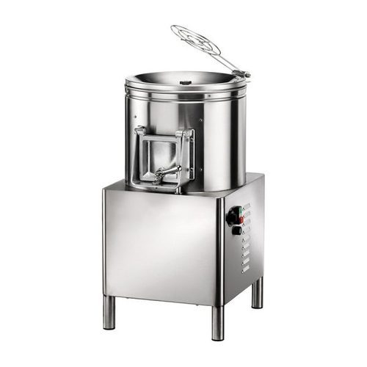
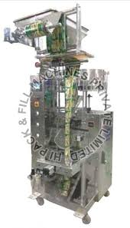
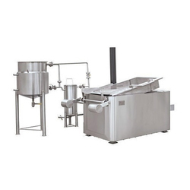
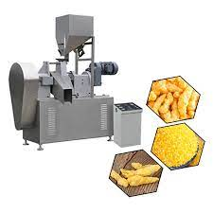
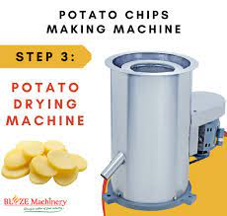
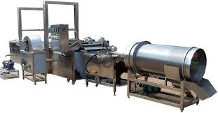
Equipment/Machine:

Slide 30
Equipment Machinery
Patota Philer:
Patota Slicer:
Dry:
48* circular Fryer Wooden boiler:
4.5ft * 2.5ft rectangular fryer with wooden boiler:
Hydro:
Flavour Application:
Kurkure Extruder:
Packing Machinery
People: Ajay,Mohan, Kajal, Dinesh

Slide 31
Preliminary Data
Global Snack Market Size: The global snack market was valued at USD 439.9 billion in 2020 and is expected to grow at a compound annual growth rate (CAGR) of 6.2% from 2021 to 2028. (Source: Grand View Research)
Top Snack Brands: According to a study by Statista, the top snack brands in the United States in 2021 based on sales were Lay's, Doritos, and Cheetos.
Health and Wellness Trends: Consumers are increasingly looking for healthier snack options, leading to the growth of the healthy snack market. A study by Technavio predicts that the healthy snack market will grow by USD 33.57 billion from 2020 to 2024.
Snack Packaging: According to a study by Research and Markets, the global snack packaging market was valued at USD 18.25 billion in 2020 and is expected to grow at a CAGR of 5.5% from 2021 to 2028.
Online Snack Sales: The COVID-19 pandemic has led to a significant increase in online snack sales. According to a study by IBISWorld, online snack sales in the United States grew by 60.8% in 2020

Slide 32
Market Validation data/Surveys conducted/Reviews by early adopters
Survey of Snack Trends: A survey conducted by The Hartman Group found that consumers are increasingly interested in healthier, plant-based, and sustainably sourced snacks.
Reviews of Healthy Snack Brands: Early adopters have reviewed and recommended several healthy snack brands, including KIND Snacks, RXBAR, and Hippeas.
Survey of Snack Packaging Preferences: A survey conducted by Ipsos found that consumers prefer resealable packaging for their snacks.
Reviews of Innovative Snack Products: Early adopters have also reviewed and recommended innovative snack products, such as Pocky sticks, Popcorners, and Bada Bean Bada Boom roasted broad beans.
Survey of Snack Purchasing Habits: A survey conducted by NPD Group found that consumers are increasingly snacking throughout the day and are looking for convenient and portable snack options.

Slide 33
MILESTONES
Sr.no. | Milestones | Activites to be Undertaken | Timeline
1 | Sales achive 15Lkh | sales | 3 Months
2 | Sales achive 25lkh | Sales | 6Months
3 | Sales achive 55 lakh | Sales | 9 Months
4 | Sales achive 70 Lakh | Sales | 12 Months

Slide 34
Need of the Hour
Head | Decription | Q-1 | Q-2 | Q-3 | Q-4 | Total | Breakup Percentage
Manpower | Worker | 1200000 | - | - | - | 1200000 | 100%
Capital Expenditure | Machinery & Other | 13000000 | - | - | - | 13000000 | 100%
Working Capital | Raw material | 5000000 | - | - | - | 5000000 | 100%
Marketing & Trials | Marketing& promotions | 2000000 | - | - | - | 2000000 | 100%
Contingency | Vechial loader | 1000000 | - | - | - | 1000000 | 100%
Total |  | 22200000 |  |  |  | 22200000 | 100%

Slide 35
How much funds are required?
2.5 Crore

Slide 36
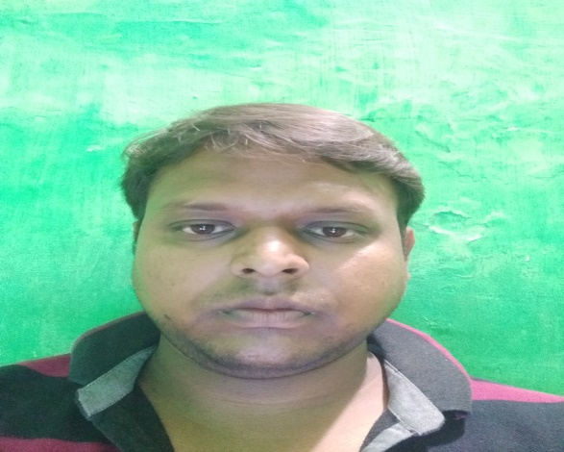
Team Members
Educational Qualifications & Strengths of:
Mr. Ajay Singh is the CEO and Founder of ARG Namkeen Private Limited. He holds a BCA degree and has over 5 years of experience in manufacturing and sales. He has a passion for food and wanted to bring the authentic, taste of indian namkeens and snacks to customers around the world, With his experience in manufacturing and sales. Mr. Singh is well-equipment to lead the company in achieving its goals. He is committed to ensuring that the company provides high-quality and authentic products while prioritizing customer satisfication. His vision is to establish the company as a leading player in the namkeen and snack market by staying true to its values and offering customers a delightful taste experience.

Slide 37

Amit Chauhan:
Mr. Amit Chauhan is a co-founder of ARG Namkeen Private Limited. He holds an MCA degree and works in the IT sector as a professional. With his technical expertise and experience in the IT industry. Mr. Chauhan is responsible for ensuring that the company’s operations are efficient and up-to-date with latest technology.
Mr. chauhan has a passion for entrepreneurship and saw an opportunity to bring traditional indian namkeens and snacks to customers globally. He is commited to ensuring that the company leverages technology to enhance efficiency and customer reach while maintaining its commitment to authenticity and quality. He vision is to establish the company as a leading player in the namkeen and snacks market, known for its diverse product range and expceptional customer service.

Slide 38
Mentors/ Advisors: None
Investors: None

Slide 39
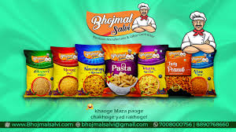
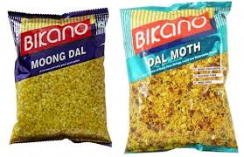
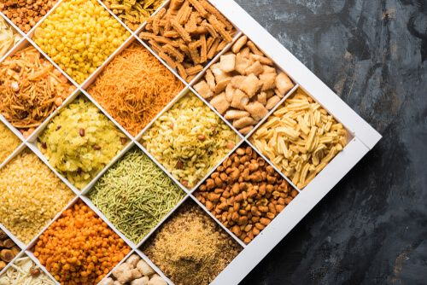
We manufacturing these types of snacks.

Slide 40

Thank You

